Slide 1
Deletions and conclusions for B+-Trees

Slide 2
Overview of video
Video discusses how to do deletions as well as a conclusion for B+-trees

Slide 3
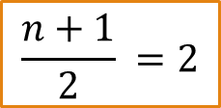
Initial tree
Height 3
13
41
n = 3
$$\frac{n+1}{2} =2$$
7
23
31
43
2
3
5
7
11
13
17
19
23
29
43
47
48
31
37
41
42
(Example from ”Database Systems: The Complete Book”)

Slide 4
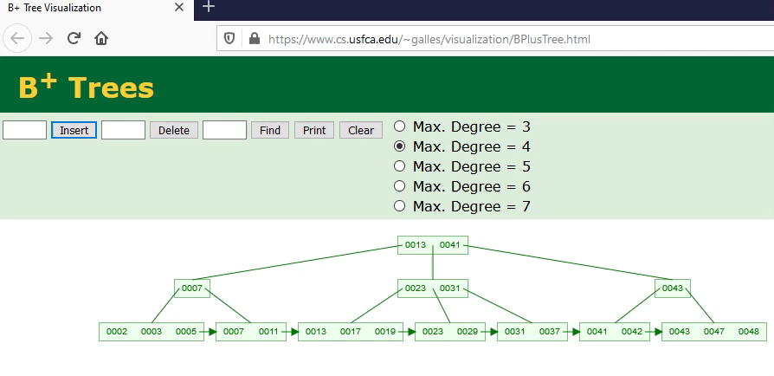
Online version of the initial tree

Slide 5
Delete 42

Slide 6

Deletion
Find value
Task: delete value 42
13
41
4$1≤$ 42
7
23
31
43
42 < 43
2
3
5
7
11
13
17
19
23
29
43
47
48
Remove value
31
37
41
42
(Example from ”Database Systems: The Complete Book”)

Slide 7
Deletion
Task: delete value 42
13
41
Clean up!
7
23
31
43
Clean up!
2
3
5
7
11
13
17
19
23
29
43
47
48
Remove value
31
37
41
(Example from ”Database Systems: The Complete Book”)
If leaf satisfies condition: Done!

Slide 8

Online version of delete 42

Slide 9
Side note
There may be more than one B+ tree with the same leaves

Slide 10
Before insertion + deletion of 42
13
7
23
31
43
2
3
5
7
11
13
17
19
23
29
31
37
41
43
47
48
(Example from ”Database Systems: The Complete Book”)

Slide 11
After insertion + deletion of 42
13
41
7
23
31
43
2
3
5
7
11
13
17
19
23
29
43
47
48
31
37
41
(Example from ”Database Systems: The Complete Book”)

Slide 12
Delete 48

Slide 13


Deletion 2
Find value
Task: delete value 48
13
41
4$1≤$ 48
43 $≤$ 48
7
23
31
43
Remove value
2
3
5
7
11
13
17
19
23
29
43
47
48
31
37
41
(Example from ”Database Systems: The Complete Book”)

Slide 14
Deletion 2
Task: delete value 48
13
41
Clean up!
7
23
31
43
Clean up!
Remove value
2
3
5
7
11
13
17
19
23
29
43
47
If leaf satisfies condition: Done!
31
37
41
(Example from ”Database Systems: The Complete Book”)

Slide 15
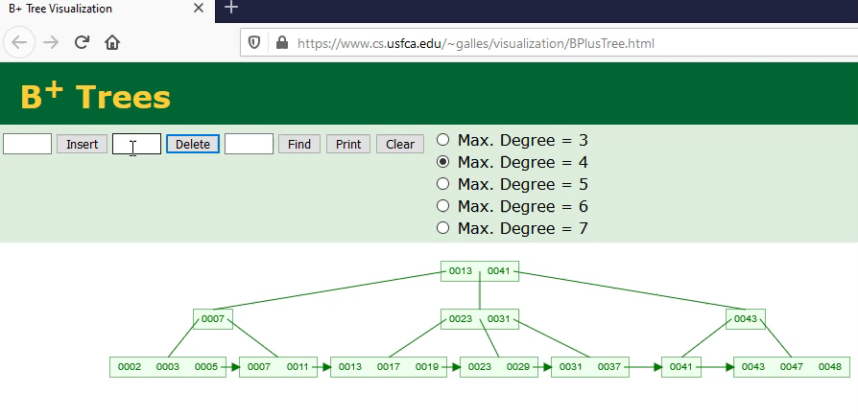
Online version of delete 48

Slide 16
Delete 41

Slide 17

Deletion 3
Find value
Task: delete value 41
13
41
4$1≤$ 41
7
23
31
43
41 < 43
2
3
5
7
11
13
17
19
23
29
43
47
Remove value
31
37
41
(Example from ”Database Systems: The Complete Book”)

Slide 18
Deletion 3
Task: delete value 41
13
41
7
23
31
43
2
3
5
7
11
13
17
19
23
29
43
47
Remove value
31
37
(Example from ”Database Systems: The Complete Book”)
If leaf satisfies condition: Done!

Slide 19
Deletion 3
Task: delete value 41
13
41
A node is adjacent to another, if they are at the same depth and their common ancestor has no descendant at that depth between them
7
23
31
43
Check if adjacent node has more than minimum
2
3
5
7
11
13
17
19
23
29
43
47
Check if adjacent node has more than minimum
31
37
(Example from ”Database Systems: The Complete Book”)

Slide 20
Deletion 3
Task: delete value 41
43
13
41
Clean up!
7
23
31
43
47
Clean up!
2
3
5
7
11
13
17
19
23
29
43
47
Steal a pointer
31
37
(Example from ”Database Systems: The Complete Book”)

Slide 21

Online version of delete 41

Slide 22
Delete 47

Slide 23


Deletion 4
Find value
Task: delete value 47
13
43
43 $≤$ 47
7
23
31
47
47$≤$ 47
2
3
5
7
11
13
17
19
23
29
47
Remove value
31
37
43
(Example from ”Database Systems: The Complete Book”)

Slide 24
Deletion 4
Task: delete value 47
13
43
7
23
31
47
If leaf satisfies condition: Done!
2
3
5
7
11
13
17
19
23
29
Remove value
Check if adjacent node has more than minimum
31
37
43
(Example from ”Database Systems: The Complete Book”)

Slide 25
Deletion 4
Task: delete value 47
13
43
7
23
31
47
2
3
5
7
11
13
17
19
23
29
Pick an adjacent node
31
37
43
(Example from ”Database Systems: The Complete Book”)

Slide 26
Deletion 4
Task: delete value 47
13
43
7
23
31
47
Merge together!
2
3
5
7
11
13
17
19
23
29
Pick an adjacent node
31
37
43
(Example from ”Database Systems: The Complete Book”)

Slide 27
Deletion 4
Task: delete value 47
13
43
7
23
31
47
Remove
2
3
5
7
11
13
17
19
23
29
31
37
43
(Example from ”Database Systems: The Complete Book”)

Slide 28
Deletion 4
Task: delete value 47
13
43
Update
7
23
31
47
2
3
5
7
11
13
17
19
23
29
31
37
43
(Example from ”Database Systems: The Complete Book”)

Slide 29
Deletion 4
Task: delete value 47
13
43
Update
Check if adjacent node has more than minimum
7
23
31
2
3
5
7
11
13
17
19
23
29
31
37
43
(Example from ”Database Systems: The Complete Book”)

Slide 30
Deletion 4
Task: delete value 47
13
43
Steal & update
7
23
31
2
3
5
7
11
13
17
19
23
29
31
37
43
(Example from ”Database Systems: The Complete Book”)

Slide 31
Deletion 4
Task: delete value 47
13
43
Steal & update
7
23
43
2
3
5
7
11
13
17
19
23
29
31
37
43
(Example from ”Database Systems: The Complete Book”)

Slide 32
Deletion 4
Update
Task: delete value 47
31
13
43
Steal & update
7
23
43
2
3
5
7
11
13
17
19
23
29
31
37
43
(Example from ”Database Systems: The Complete Book”)

Slide 33
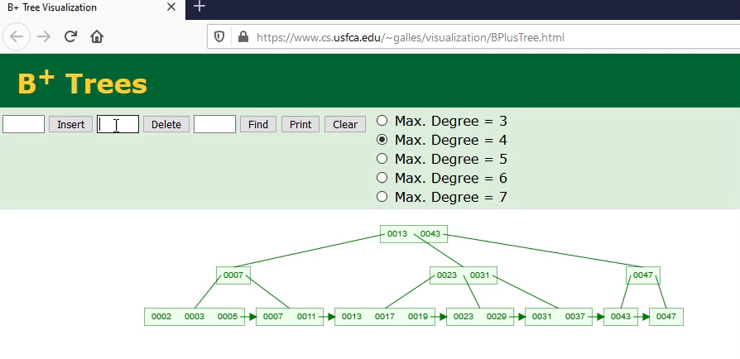
Online version of delete 47

Slide 34
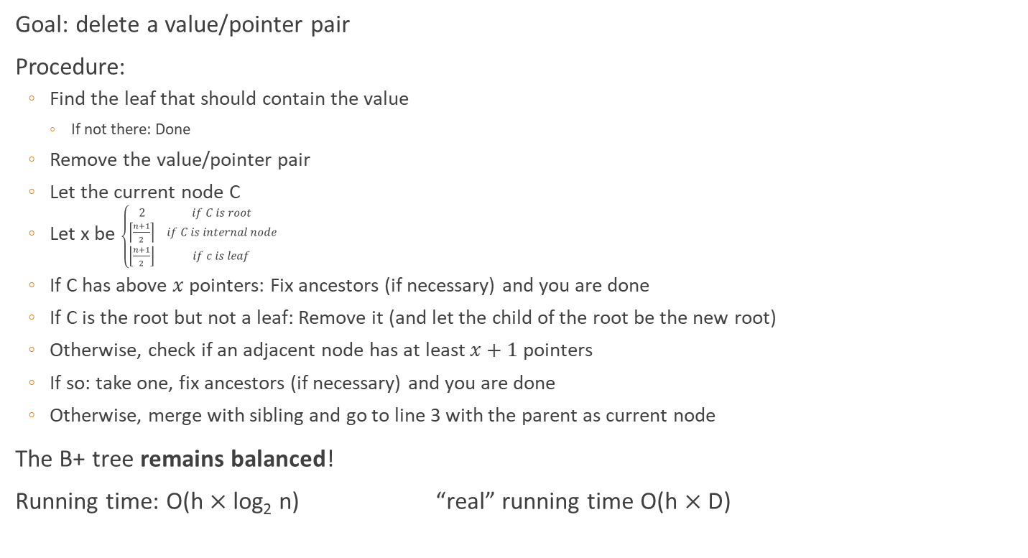
Review: Deletion
Goal: delete a value/pointer pair
Procedure:
Find the leaf that should contain the value
If not there: Done
Remove the value/pointer pair
Let the current node C
Let x be $\left\{\begin{matrix}2 & if C is root \\ \left\lceil \frac{n+1}{2}\right\rceil & if C is internal node \\ \left\lfloor \frac{n+1}{2}\right\rfloor & if c is leaf\end{matrix}\right.$
If C has above $x$ pointers: Fix ancestors (if necessary) and you are done
If C is the root but not a leaf: Remove it (and let the child of the root be the new root)
Otherwise, check if an adjacent node has at least $x+1$ pointers
If so: take one, fix ancestors (if necessary) and you are done
Otherwise, merge with sibling and go to line 3 with the parent as current node
The B+ tree remains balanced!
Running time: O(h $×$ log₂ n) “real” running time O(h $×$ D)
See definition slide 19
Time for a disk operation
Height of the B+ tree

Slide 35
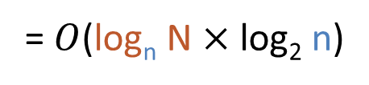
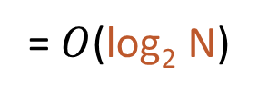
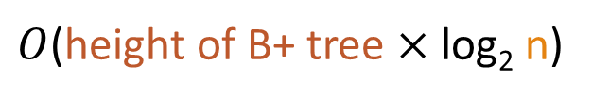
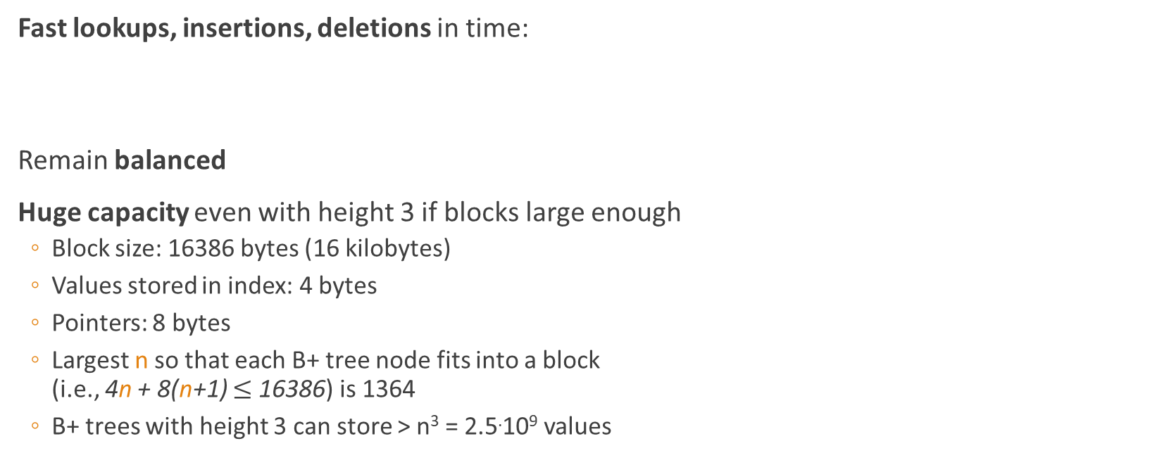
Properties of B+ Tree Indexes
Fast lookups, insertions, deletions in time:
Remain balanced
Huge capacity even with height 3 if blocks large enough
Block size: 16386 bytes (16 kilobytes)
Values stored in index: 4 bytes
Pointers: 8 bytes
Largest n so that each B+ tree node fits into a block (i.e., 4n + 8(n+1) $≤$ 16386) is 1364
B+ trees with height 3 can store > n³ = 2.5.10⁹ values
n ≈ B
$O$(height of B+ tree $×$ log₂ n)
= $O$(log_{n} N $×$ log₂ n)
= $O$(log₂ N)

Slide 36
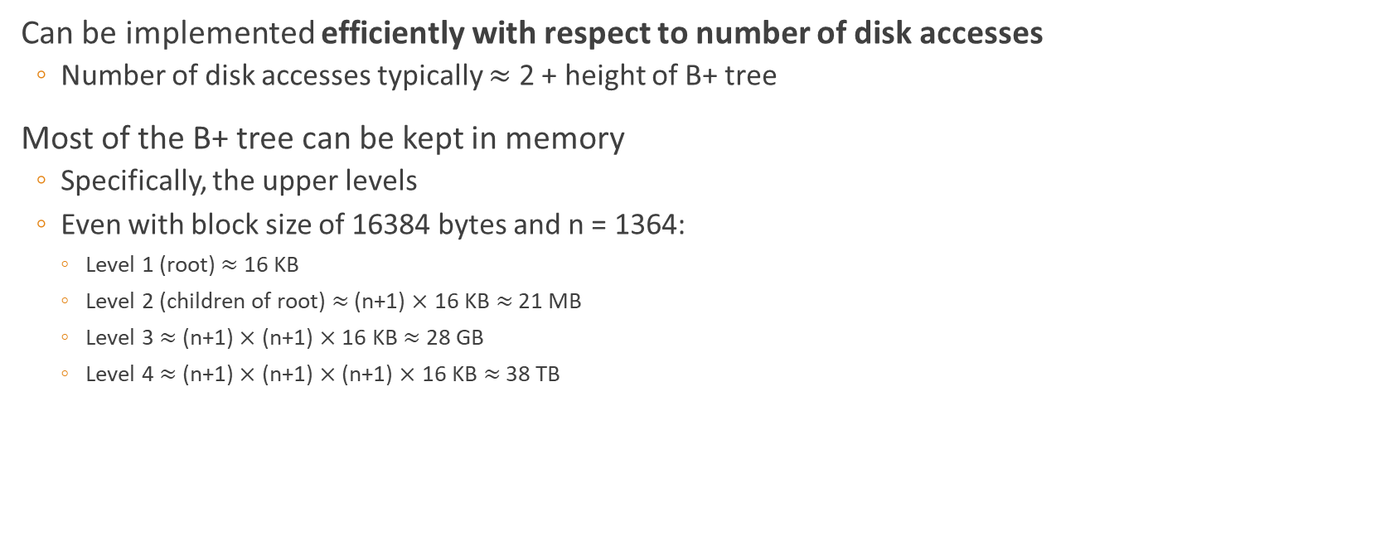
Properties of B+ Tree Indexes
Can be implemented efficiently with respect to number of disk accesses
Number of disk accesses typically $≈$ 2 + height of B+ tree
Most of the B+ tree can be kept in memory
Specifically, the upper levels
Even with block size of 16384 bytes and n = 1364:
Level 1 (root) $≈$ 16 KB
Level 2 (children of root) $≈$ (n+1) $×$ 16 KB $≈$ 21 MB
Level 3 $≈$ (n+1) $×$ (n+1) $×$ 16 KB $≈$ 28 GB
Level 4 $≈$ (n+1) $×$ (n+1) $×$ (n+1) $×$ 16 KB $≈$ 38 TB
Typically, these are the leaf nodes and can be loaded from disk on demand

Slide 37

Summary
We can do each operation (search, insertion and deletions) in a B+-tree in time
$O$(height of B+ tree $×$ log₂ n) or
$O$(height of B+ tree $×$ D)
Slide 34 contains a summary of how to do deletions

